Slide 1





Odoo ERP Project “Pharmacy Data Analysis and Business Intelligence Dashboard”

Slide 2

Project Team
Asmaa Hussein Zayed
Dalia Ashraf Nour
Hager Saleh Ahmed
Mahmoud Ashraf Mohamed
Omar Abd El-Moneam Marouf
Sarah Ahmed Mohamed
Group Code:
ONL2_DAT1_G8
Technical Instructor:
Jakie Abu Aleam

Slide 3

Agenda: Project Overview Problem Statement Objectives Data Exploration Data Analysis and Dashboards Key Insights

Slide 4
Goal: This project aims to develop a business intelligence dashboard for pharmacy operations. Tools used: Extracting data from Odoo, storing and processing it in SQL, utilizing Python for ETL (Extract, Transform, Load), and building an interactive Power BI dashboard. Benefits: The primary objective is to leverage data-driven insights to enhance decision-making, drive sales growth, improve operational efficiency, and support to know customer Behavior.
Project Overview

Slide 5
Problem Statement Pharmacies generate vast amounts of sales and inventory data, but without proper analysis, valuable insights remain untapped. Manual reporting methods are time-consuming, error-prone, and lack real-time visibility into sales trends, customer behavior, and inventory management. This leads to inefficiencies such as stockouts, overstocking, missed sales opportunities, and difficulties in strategic decision-making. Additionally, the absence of a centralized business intelligence system makes it challenging to track performance metrics and optimize operations. This project addresses these challenges by leveraging Odoo ERP, SQL, Python-based ETL processes, and Power BI to create an interactive dashboard that provides real-time insights and supports data-driven decision-making.

Slide 6
* Extract and structure data from Odoo ERP. * Automate ETL processes with Python * Clean and validate data * Develop interactive Power BI dashboard * Deliver insights on sales, inventory, and customer behavior
Goals & Objectives:

Slide 7
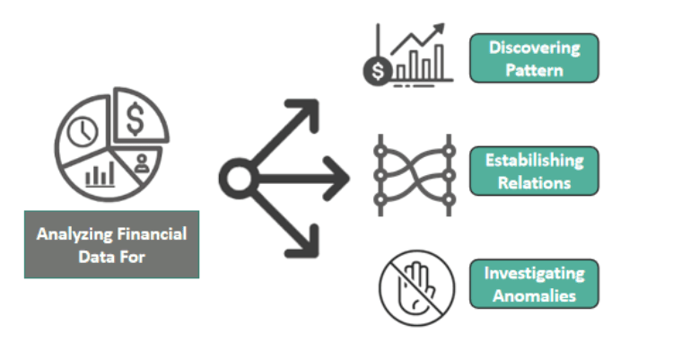
Data Exploration

Slide 8
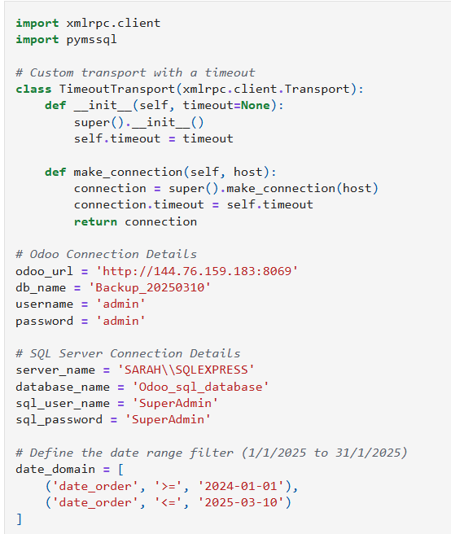
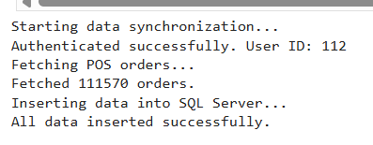
Data Collecting and Connecting SQL to Odoo:

Slide 9
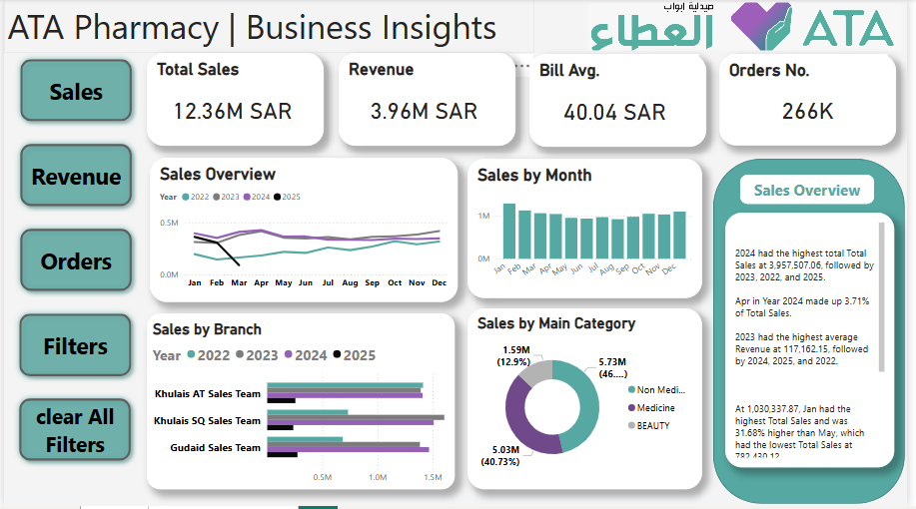
Data Analysis and Dashboards
Dashboard link: ATA Pharmacy Sales Analysis - Power BI

Slide 10
Pareto Analysis (R/K Classification): 20% of items (R) account for 80% of sales. R items need tighter inventory control and monitoring. ABCD Item Classification: Class A: Sold ≥ 3 times → High demand, priority restocking Class B: Sold 2 times → Moderate demand Class C: Sold once → Low demand Class D: Not sold → Candidates for phase-out or promotion
Data Analysis & Insights

Slide 11
Branch Performance:
Identified top-performing branches by sales
Highlighted branches with zero sales in the last 3 months
Zero-sales percentage used to classify performance:
High: >10%
Moderate: 5–10%
Low: <5%

Slide 12
Sales Trends:
Sales growth monitored across all branches
Seasonal sales peaks and declines identified
Supports forecasting and marketing efforts
Inventory Optimization:
Recommended stock levels based on past 3-month sales
Ensures minimum 30-day stock availability

Slide 13
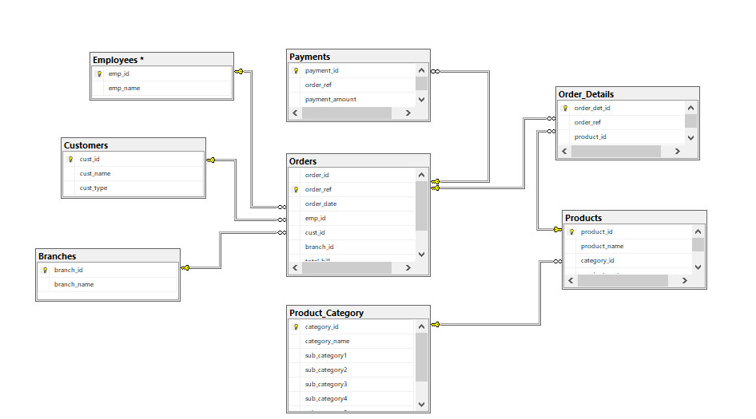
Analysis Scheme

Slide 14
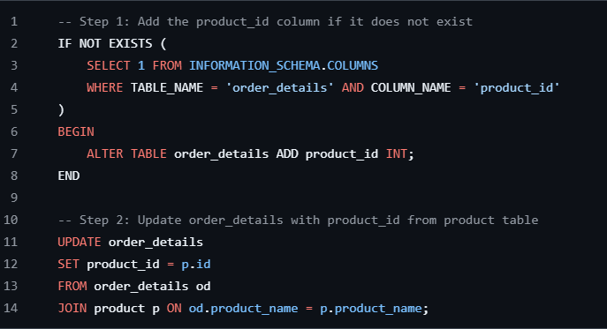
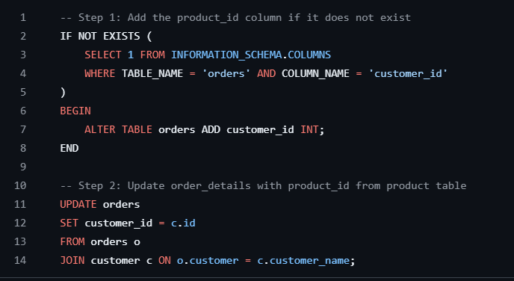
SQL Queries

Slide 15
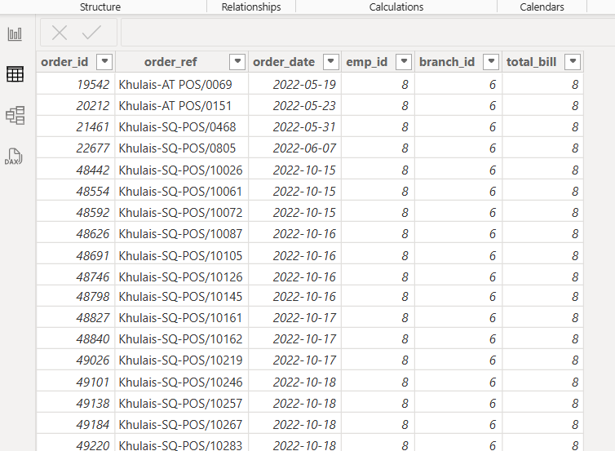
Power Query

Slide 16
Power Bi Dashboard

Slide 17
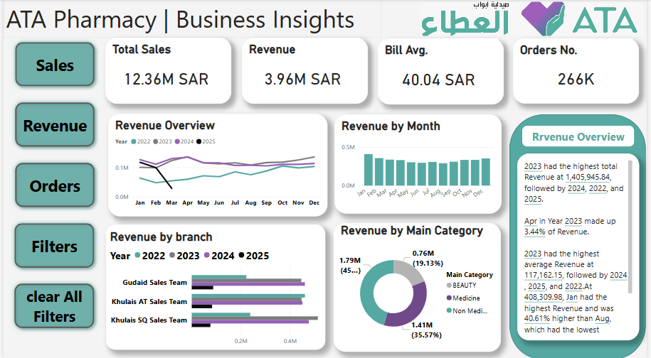
Power Bi Dashboard

Slide 18
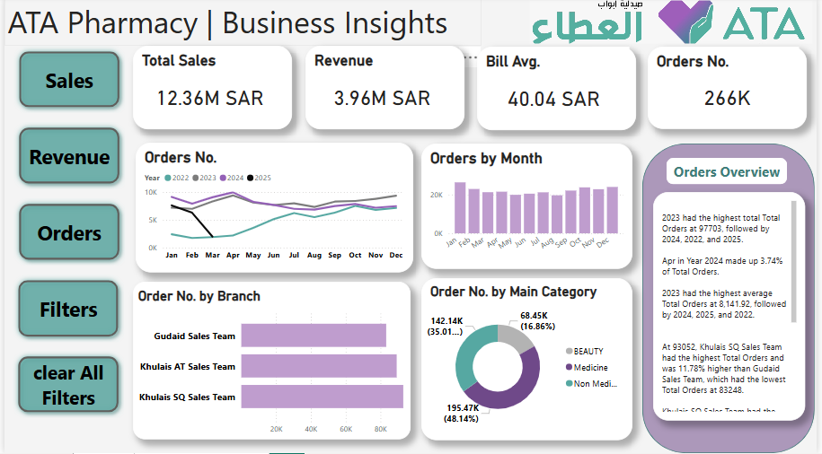
Power Bi Dashboard

Slide 19
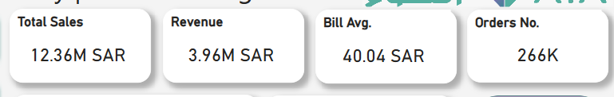
Key Insights
Sales Insights
What is the total sales amount over a specific time?
Which branches have the highest total sales?
How many orders are placed monthly/annualy?
What is the average bill amount per order?
Product Analysis
Which products are sold the most?
Which product categories or subcategories generate the most revenue?

Slide 20
KPI tracked:
Dashboard accuracy ≥ 98%
User engagement ≥ 80%
Training completion ≥ 90%
Decision impact ≥ 85%
Sales trend accuracy ≥ 95%
Conclusion
Efficient, automated business intelligence system
Real-time insights drive smarter decisions
Scalable solution for continued growth

Slide 21
Thank you
Q & A ?!

